Slide 1
Introduction to Python
Class #2 – Numbers and Conditionals

Slide 2
Numbers

Slide 3
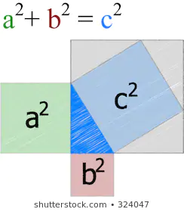
Variable types
Integer (number)
Float (number)

Slide 4
round()
https://docs.python.org/3.7/library/functions.html?highlight=round#round
round(number[, ndigits])
Return number rounded to ndigits precision after the decimal point. If ndigits is omitted or is None, it returns the nearest integer to its input.

Slide 5
Let’s try
round(2.5)
round(3.5)
What’s going on?

Slide 6
.1 + .2

Slide 7
Complex numbers
X = 1 + 2j
Real number → i → number.real
Imaginary Number → j → number.imag
Conjugate → number.conjugate()

Slide 8

Open repl.it →
“2.1. Numbers: Two digits” to
“2.D. Numbers: School desks”

Slide 9
import math
from math import sqrt

Slide 10
import math
A python base package for mathematical functions.
e.g. math.ceil(x)
Let’s take a look at the documentation...

